Slide 1








Team Name: Him-Sarthi
Domain: Smart Vehicle(Software)
PSID: SIH1382
Problem Statement Title: Real-Time Vehicle Tracking System
Ministry: Government of Himachal Pradesh
Theme Name: Smart Vehicle

Slide 2

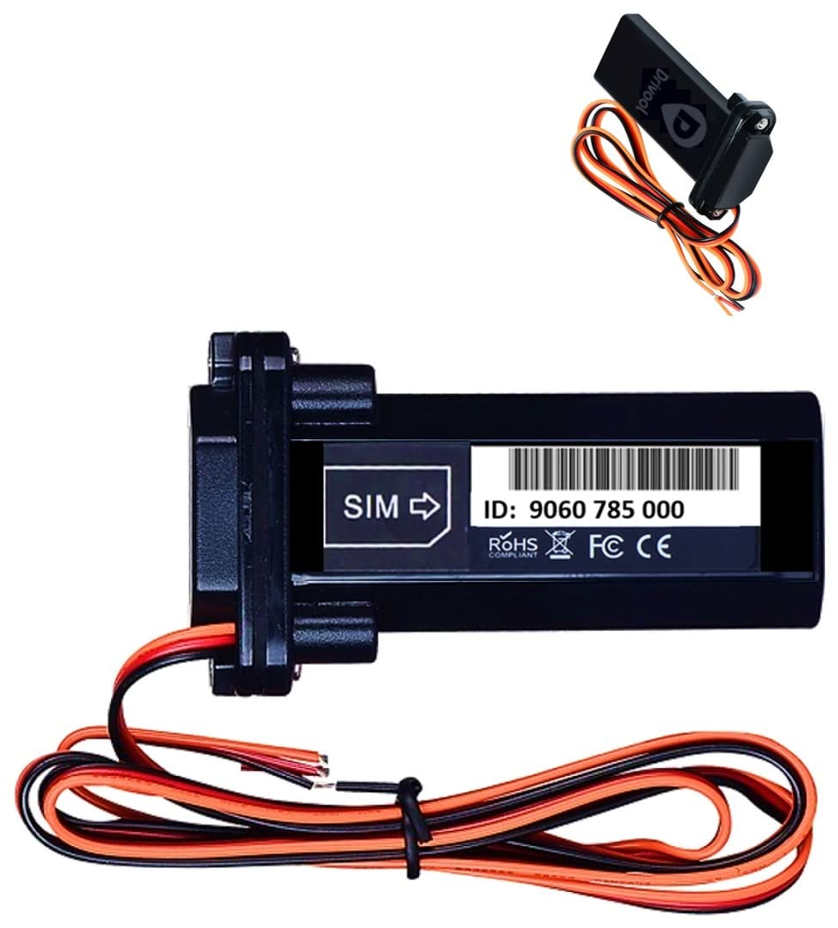
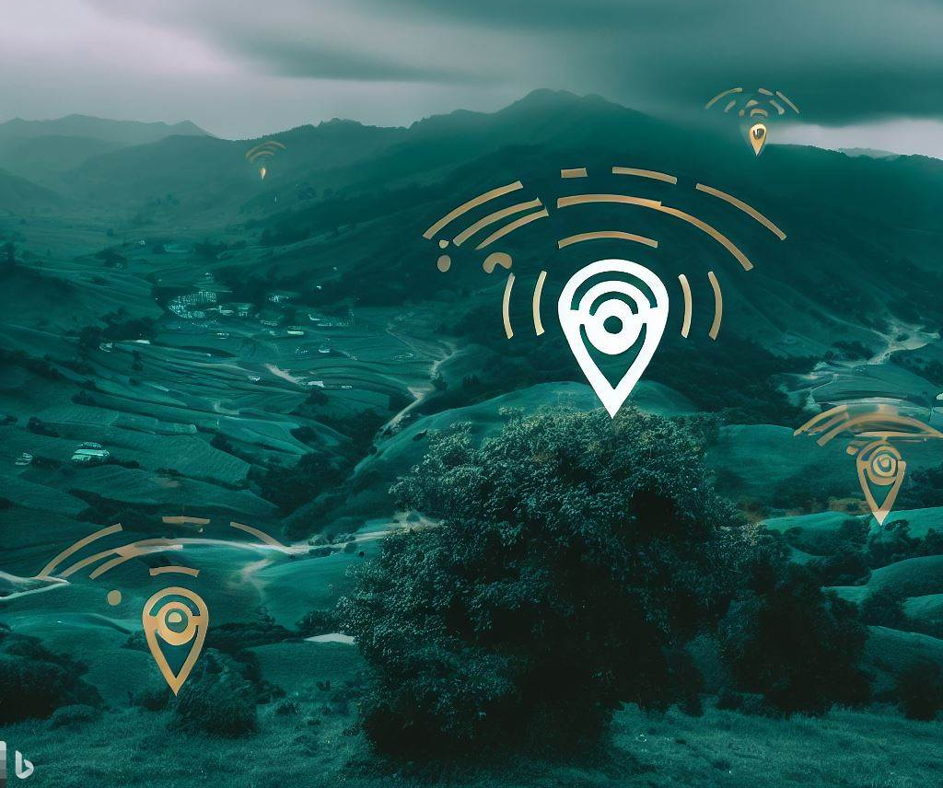
Idea and Solution
The absence of live bus tracking system for people and bus management system for Himachal government (HRTC). Currently, there is no reliable means to locate buses of various types at any station, live track their positions, or reserve and confirm seats in advance. Furthermore, there is a lack of a unified system to monitor and manage the entire fleet of buses operating within the state.
A web application( App + Website ) that integrates all the User needs to track & search, live bus location, bus routes, book and reserve seats with simple UI experience. A bus management system for the government to track all the buses, drivers, passenger, routes and other analytics with elevated visualization. Some over the top brief details of the solution includes:
Real-Time Bus Tracking : Accurate bus tracking using Drivool 890-IN GPS Tracking Device and Geofencing integrated with 10+ Google API’s providing users and admin to track live bus locations, Speed , traffic , time , sub-stations etc. for every route buses of all type for better scheduling.
Reliable Bus Management System : Developed New Route Algorithm to crack the unsolved problem of substation inconsistency in the current applications streamlined with ACID compliance of optimized Heroku MySQL Database.
Clean and Minimalist UI-Experience: Quick & responsive React JS Front-end and robust Back-end using Angular with Flask , Google Firebase , Bootstrap , Node JS , Express JS and Typescript.

Slide 3

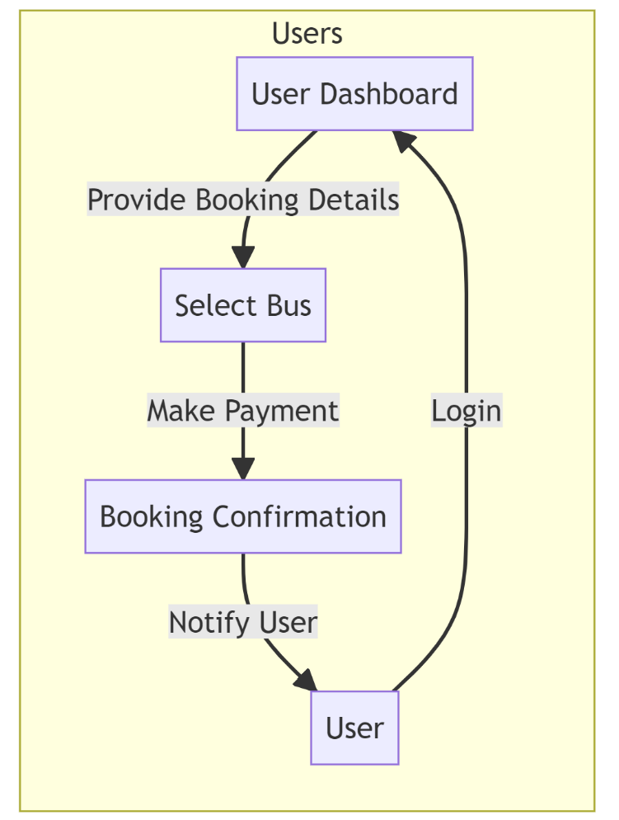
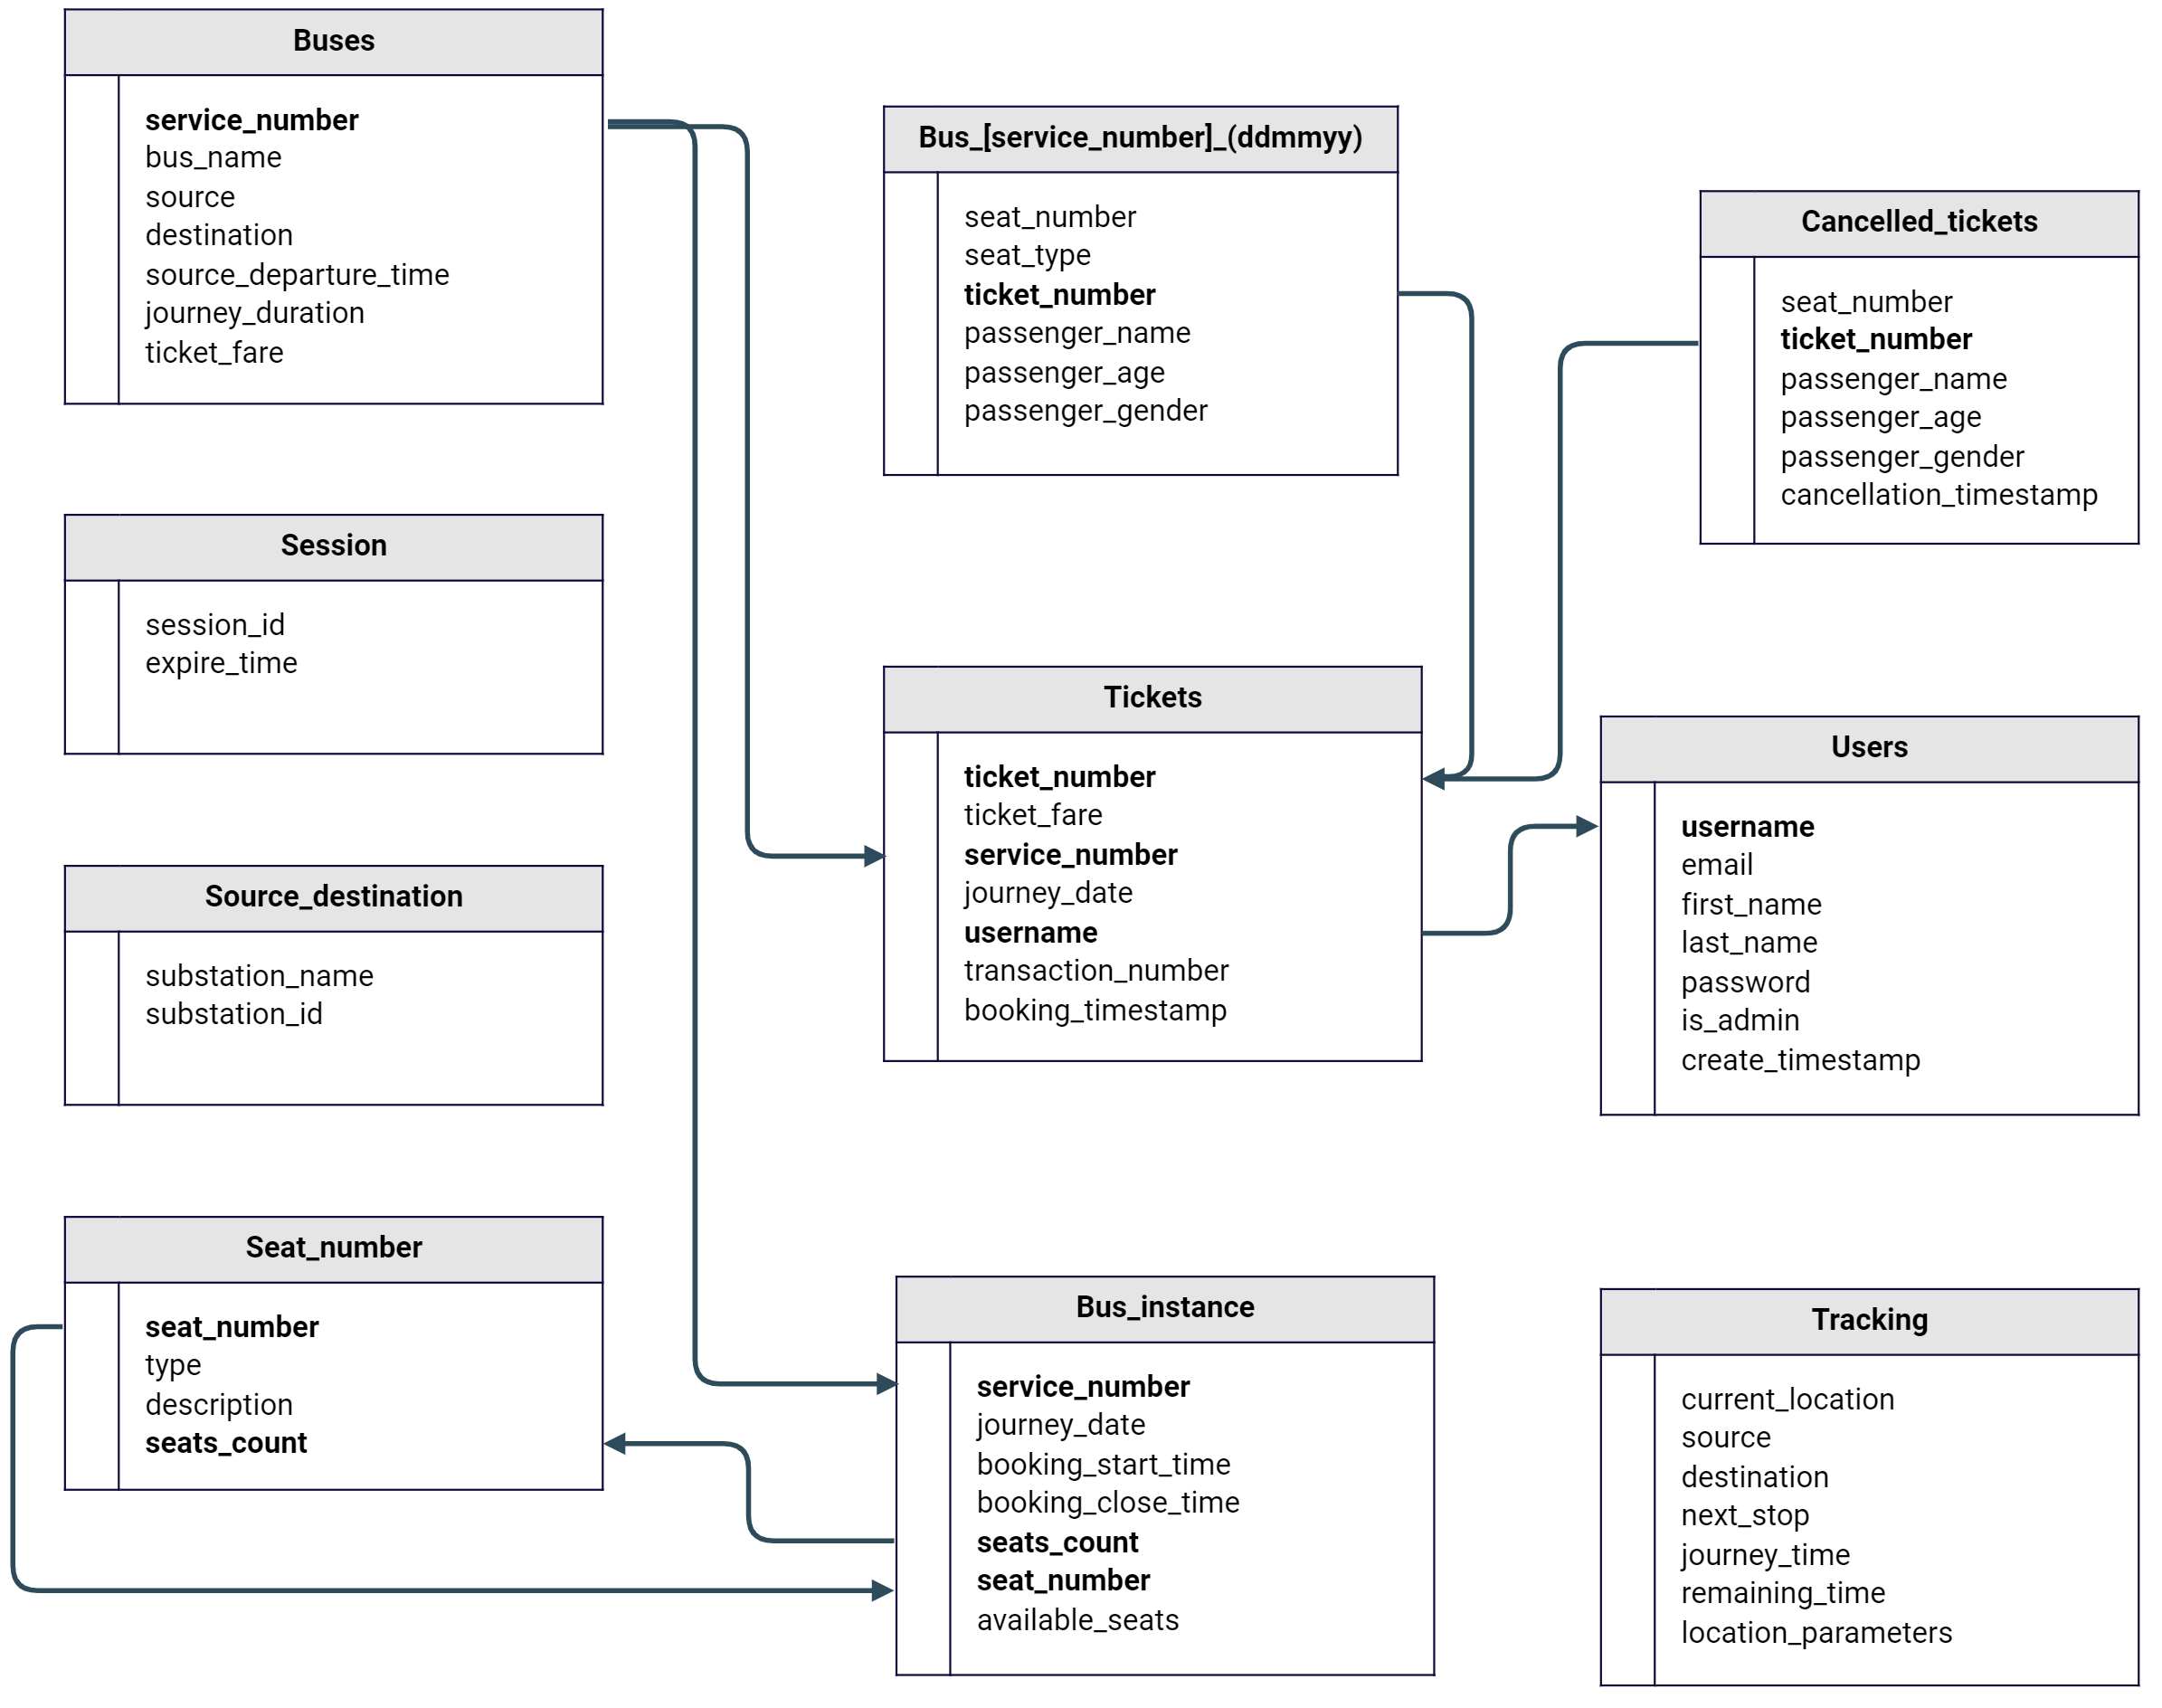
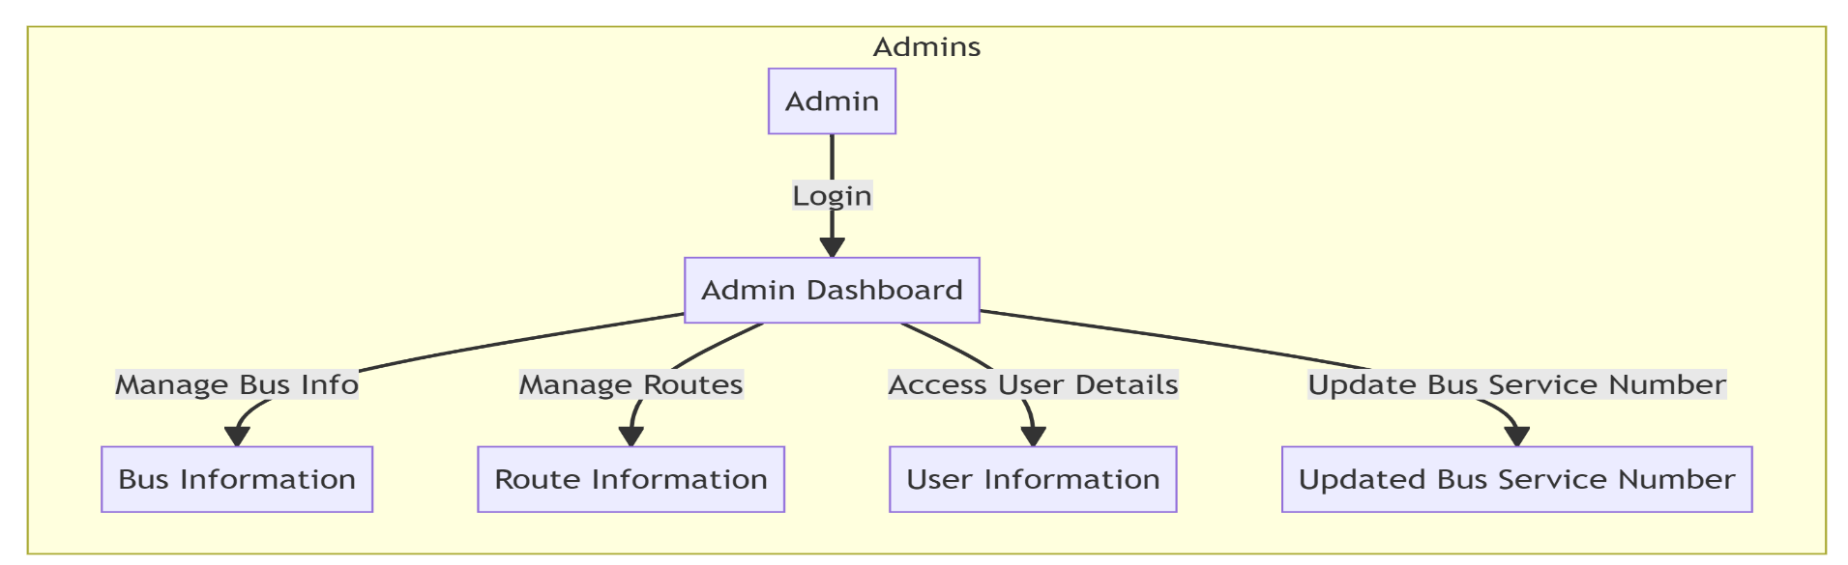
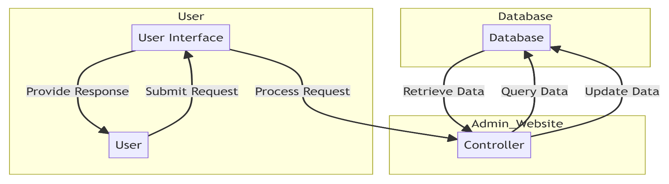
Flowchart of Database
Tech-Stack used
User portal flow
Frameworks Integration flow & Admin Portal access

Slide 4
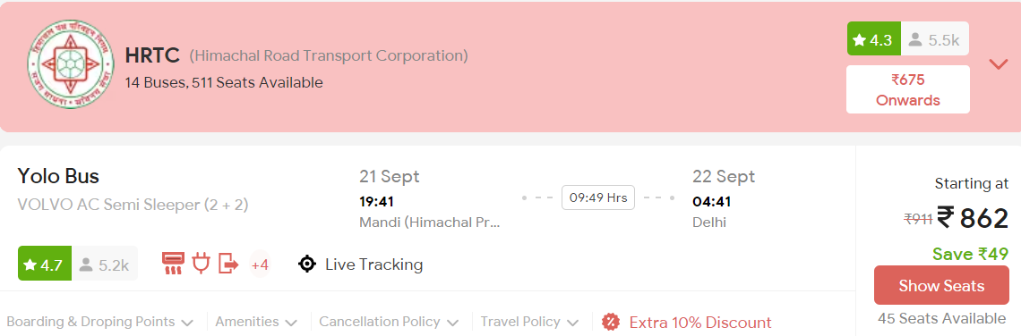
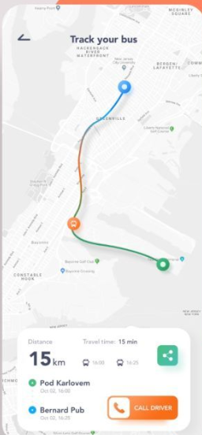
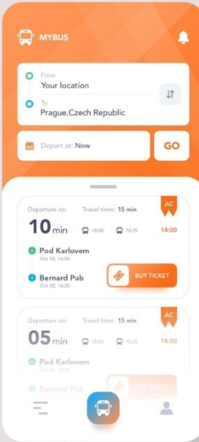
Differentiating Factor, Dependencies and Use Case
Drivool 890-IN GPS : The tracking device offers affordable, optimized tracking, designed for reliability in low-network zones, including hilly terrain. Its standout feature is its precision in challenging weather conditions. Our GPS device dependency ensures accurate live tracking data with minimum ping, supporting efficient route direction matrix and monitoring within the application.
Substation Inconsistency Problem : Existing applications lack inter-substation result for the user services, but our New Database Algorithm bridges this gap by offering seamless transportation user convenience between any substation. The algorithm not only amplifies the application queries response and structures the database management for engineers but also establishes & maintains the data security.
Data Management and visualization : The project forks into 2 section ; user and admin. The user level incorporates errorless booking , real time schedules , trip planning , cost estimation , e-ticketing and flexible payment whereas the admin level has added features to observe the live tracking , fuel consumption , emergency support , passengers and driver information , inferenced 3D Analytics and optimizing algorithms for all.
Visual Design and Layouts : Our project prioritize the user satisfaction by providing a top notch interaction platform using responsive frameworks like Material UI , Adobe XD ,Hotjar etc. It completely optimizes the performance, responsiveness, gestures, personalization in the navigation, accessibility, typography and buttons. The impression of our application leaves with positive emotion resulting in the increased engagement and high usability.

